Slide 1
Chapter 3
What Do Interest Rates Mean and What Is Their Role in
Valuation?

Slide 2
Financial System Overview (2)
Financial Markets
Financial Institutions
Bond Market (3,5,12)
Stock Market (13,6)
Money Market (11)
Mortgage Market (14)
Why Exists (7)
Banking Industry (19)
Mutual Fund Industry(20)
Hedging with Financial Derivatives (24)

Slide 3
Chapter 3: What do Interest Rates Mean and What is Their Role in Valuation?
Interest Rate Fundamentals
Time value of Money and Interest Rates
Present Value
Several measures for interest rates:
Yield to Maturity
Simple loan
Fixed-payment loan
Coupon bond
Discount bond
Current Yield
Yield on a Discount Basis
Relation between Interest Rate and Return
Real Interest Rate and Nominal Interest Rate

Slide 4
Interest Rate Fundamentals
Nominal Interest Rates: the interest rate actually observed in financial markets
Directly affect the value (price) of most securities traded in the market
Compound interest: interest earned on an investment is reinvested
Simple interest: interest earned on an investment is not reinvested
Calculation of Simple Interest
Example: $1,000 to invest for a period of two years at 12% (simple interest), then how much you will get in the following two years?
$1,000+$1,000*12%+$1,000*12%=$1,240
Calculation of compound Interest
Example: $1,000 to invest for a period of two years at 12% (compound interest), then how much you will get in the following two years?
$1,000+1,000*12%+($1,000+$1,000*12%)*12%
=$1,000[1+2*12%+12%²]=$1,000*(1.12)²=$1,254.40

Slide 5
Present Value
Present value (present discounted value): a dollar paid to you in the future is less valuable to you than a dollar paid to you today.
Let’s assume you just hit the $20 million jackpot in the New York State Lottery, which promise you a payment of $1 million for the next 20 years. You are clearly excited for sure, but if you need all the money now, will they pay you $20 million? (we assume today you will get the first 1 million)
No.
Let’s assume the interest rate is 10%, so
First year: $1 million
Second year: 1/(1+0.1)=$0.909 million
Third year: 1/(1+0.1)²=$0.826 million
…..
Tenth year: 1/(1+0.1)⁹=$0.424 million
Total Present Value: $9.4 million
Present value decreases as Interest rates increase

Slide 6
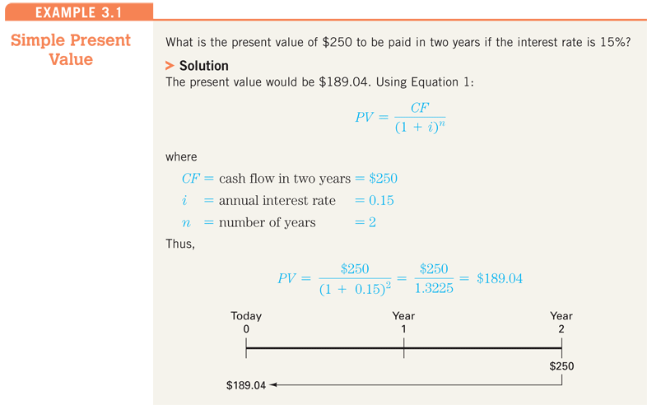

Slide 7
Present Value Applications
There are four basic types of credit instruments which incorporate present value concepts:
PV
Simple loan
Fixed payment loan
Coupon bond
Discount bond

Slide 8
Several Measures of Interest Rates
Yield to maturity: the interest rate that equates the present value of payments received from a debt instrument with its value today.
Current yield: the yearly coupon payment divided by the price of the security.
Yield on a discount basis: very close to the calculation of discount rate.

Slide 9
Yield to Maturity: Simple Loan
Simple loan: the lender provides the borrower with an amount of funds that must be repaid to the lender at the maturity date, along with an additional payment for the interest.
Simple loan of $100 at 10% interest
suppose today’s value is $100, one year late, the borrower will pay $110, so how to decide the yield to maturity?
$100 = $110/(1 + i) ⇒ i =0.10

Slide 10
Yield to Maturity: Fixed Payment Loans
Fixed Payment Loan: the lender provides the borrower with an amount of funds, which must be repaid by making the same payment every period, consisting of part of the principal and interest for a set number of years. (borrow $1000, and pay $126 in following 25 years)
$126 $126 $126 $126
$1000 = + + + ... +
(1+i) (1+i)² (1+i)³ (1+i)²⁵
FP FP FP FP
LV = + + + ... +
(1+i) (1+i)² (1+i)³ (1+i)^{n}
LV: loan value; FP: fixed yearly payment
N: number of years until maturity

Slide 11
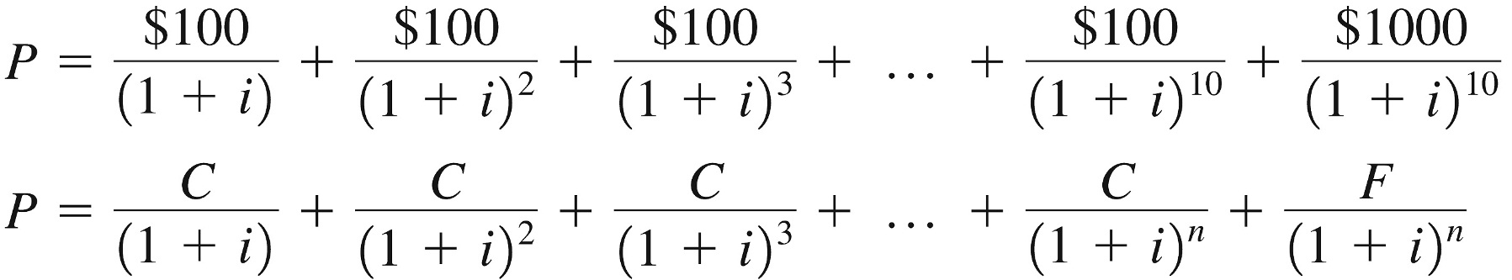
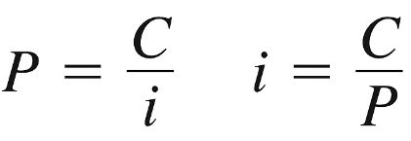
Yield to Maturity: Bonds
Coupon Bond (Coupon rate = 10% = C/F)
Consol: Fixed coupon payments of $C forever

Slide 12
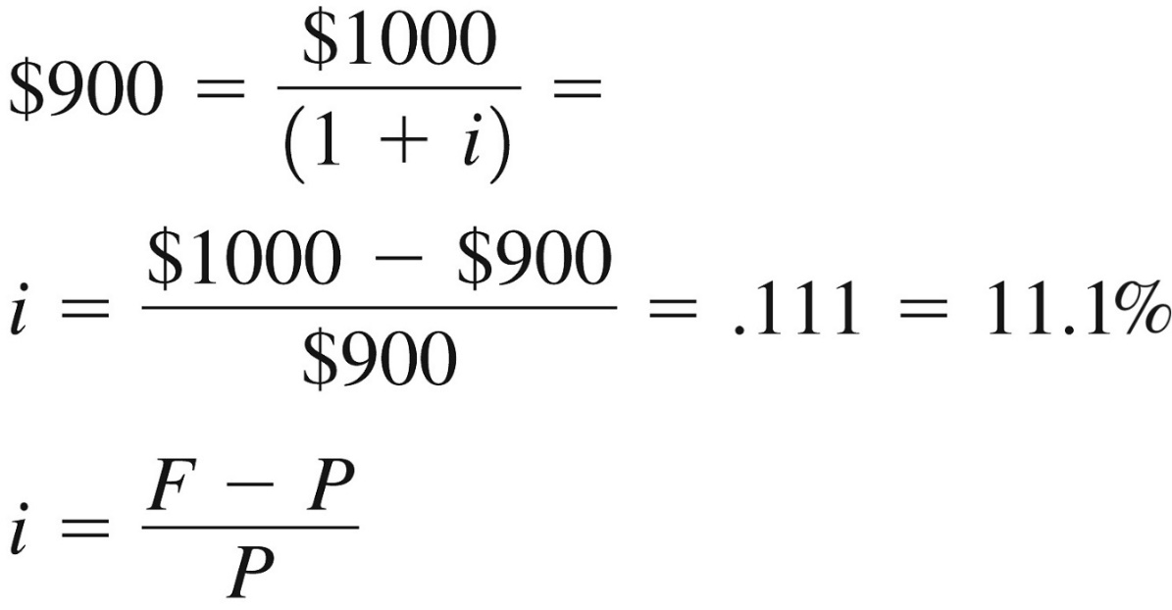
Yield to Maturity: Bonds
One-Year Discount Bond (P = $900, F = $1000)

Slide 13
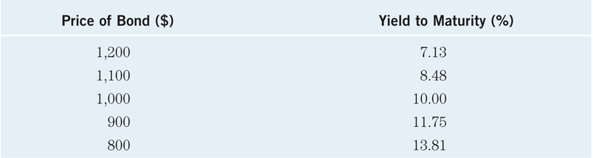
Relationship Between Price and Yield to Maturity
Table 3.1 Yields to Maturity on a 10% Coupon Rate Bond Maturing in 10 Years (Face Value = $1,000)
Three interesting facts in Table 3.1
When bond is at par, yield equals coupon rate
Price and yield are negatively related
Yield greater than coupon rate when bond price is below par value

Slide 14
Other Measures of Interest Rates
Yield to maturity is the most accurate measure of interest rates, however, it is very difficult to calculate. So, other, less accurate of interest rates have come into common use in bond market.
Current yield
Yield on a discount basis
Current Yield: yearly coupon payment divided by the price of the security
i_{c} = C/P
Two Characteristics
The current yield better approximates the yield to maturity when the bond’s price is nearer to the bond’s par value and the maturity of the bond is longer. It become a worse approximation when the bond’s price is further from the bond’s par value and the bond’s maturity is shorter.
Change in current yield always signals change in same direction as yield to maturity.

Slide 15
Other Measures of Interest Rates
2. Yield on a Discount Basis
(F – P) 360
i_{db} = x
F (number of days to maturity)
One year bill, P = $900, F = $1000
$1000 – $900 360
i_{db} = x = 0.099 = 9.9%
$1000 365
Two Peculiarities:
It uses the percentage gain on the face value of the bill (F-P)/F rather than the percentage gain on the purchase price of the bill (F-P)/P used in calculating the yield to maturity.
It puts the yield on an annual basis by considering the year to be 360 days rather than 365 days.
Two Characteristics
1. Understates yield to maturity; longer the maturity, greater is understatement
2. Change in discount yield always signals change in same direction as yield to maturity

Slide 16
Global: Negative T-Bill Rates? It Can Happen
In November 1998, rates on Japanese 6-month government bonds were negative (-0.004%)!
In September 2008, rate on 3-month US T-bills fell very slightly below zero for a very brief period.
Investors were willing to pay more than they would receive in the future.
Best explanation is that large investors found the convenience of the bills worth something—more convenient than cash. But that can only go so far—the rate was only slightly negative.

Slide 17
Chapter Outline
Measuring Interest Rates
The Distinction Between Real and Nominal Interest Rates
The Distinction Between Interest Rates and Returns

Slide 18
Distinction Between Real and Nominal Interest Rates
Real interest rate
Interest rate that is adjusted for expected changes in the price level
i_{r} = i – π^{e}
Real interest rate more accurately reflects true cost of borrowing
When the real rate is low, there are greater incentives to borrow and less to lend
We usually refer to this rate as the ex ante real rate of interest because it is adjusted for the expected level of inflation. After the fact, we can calculate the ex post real rate based on the observed level of inflation.

Slide 19
Distinction Between Real and Nominal Interest Rates (cont.)
If i = 5% and p^{e} = 0% then
If i = 10% and p^{e} = 20% then
Happened in HK!

Slide 20
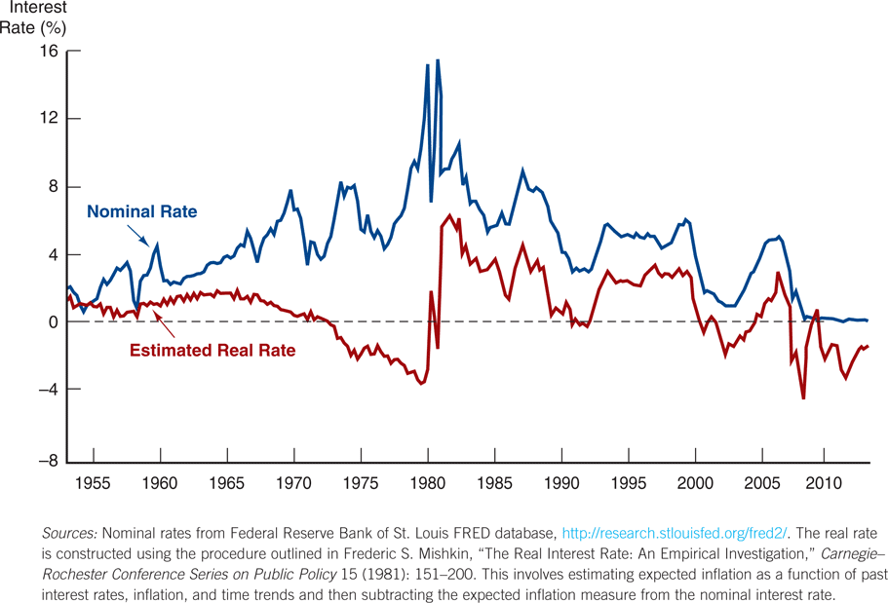
U.S. Real and Nominal Interest Rates
Figure 3.1 Real and Nominal Interest Rates (Three-Month Treasury Bill), 1953–2013

Slide 21
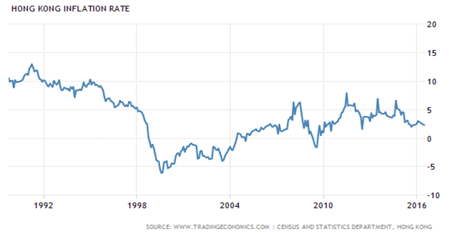
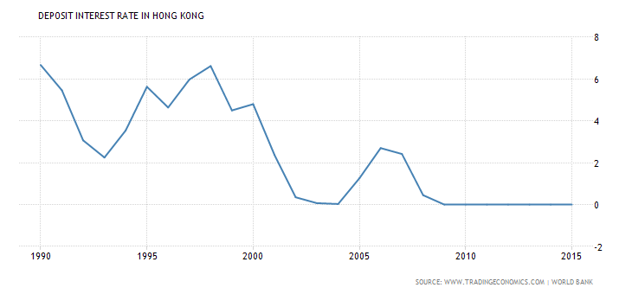

Slide 22
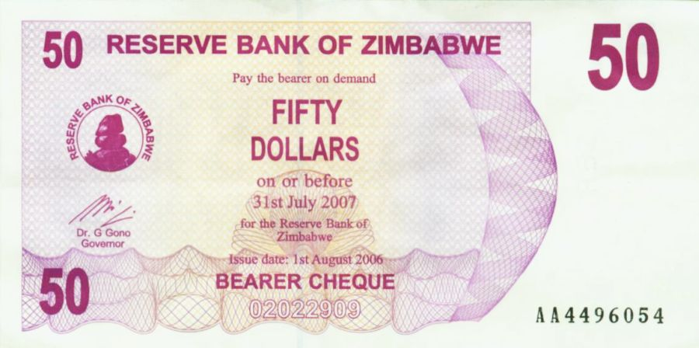
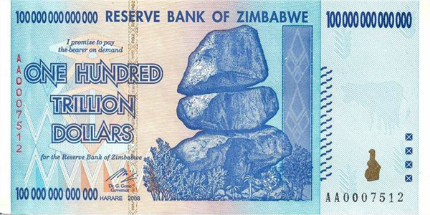
Inflation in Zimbabwe is more than 231,000,000% in 2008

Slide 23
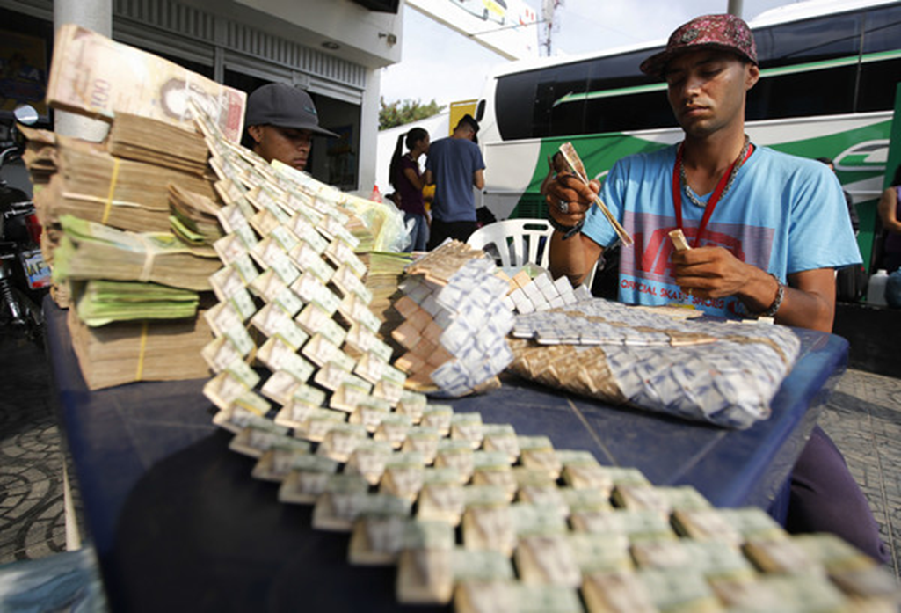
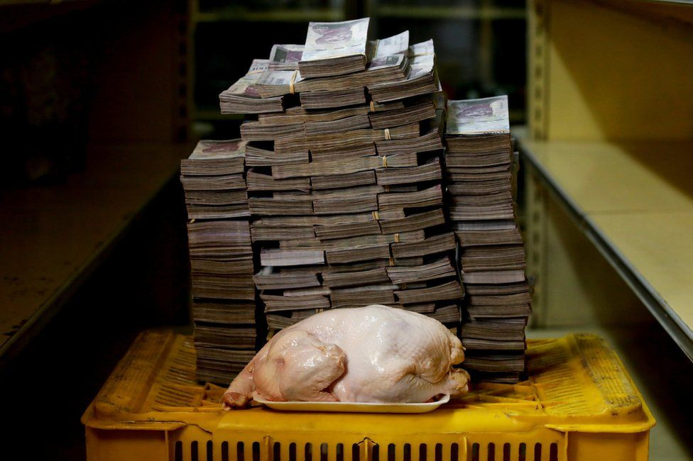
Venezuela:
181% in 2015
800% in 2016
4,000% in 2017
200,000% in 2018
Venezuela:
One 2.4KG chicken costs 14,600,000

Slide 24
Chapter Outline
Measuring Interest Rates
The Distinction Between Real and Nominal Interest Rates
The Distinction Between Interest Rates and Returns

Slide 25
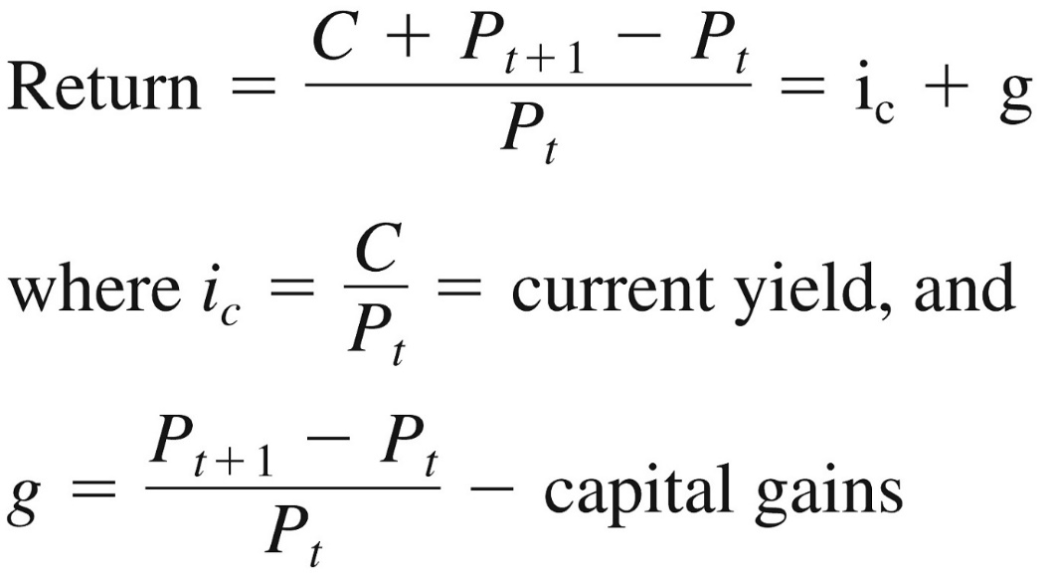
Distinction Between Interest Rates and Returns
Is Interest Rate a good indicator for investors?
If Bob hold a long-maturity bond which interest rate is 10%, however, when the interest rate rises to 20%, Bob will lose his shirt if he has to sell the bond!! For investors, return is a much better indicator.
Rate of Return: we can decompose returns into two pieces:

Slide 26
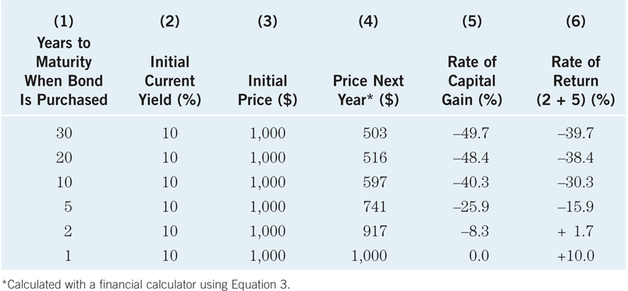
Key Facts about the Relationship Between Rates and Returns
Table 3.2 One-Year Returns on Different-Maturity 10% Coupon Rate Bonds When Interest Rates Rise from 10% to 20%
Sample of current coupon rates and yields on government bonds
http://www.bloomberg.com/markets/iyc.html

Slide 27
Maturity and the Volatility of Bond Returns
Key Findings from Table 2
1. Only bond whose return = yield is those which maturity = holding period
2. For bonds with maturity > holding period, i ↑ P↓ implying capital loss
3. Longer is maturity, greater is % price change associated with interest rate change
4. Longer is maturity, more return changes with change in interest rate
5. Bond with high initial interest rate can still have negative return if i ↑
Conclusion from Table 2 Analysis
Interest-rate risk: the riskiness of an asset’s return that results from interest-rate changes.
1. Prices and returns for long-term bonds are more volatile than those for shorter-term bonds, longer-term bonds have higher interest-rate risk
2. No interest-rate risk for any bond whose maturity equals holding period

Slide 28
Reinvestment Risk
Reinvestment risk: If an investor’s holding period is longer than the term to maturity of the bond, because the proceeds from the short-term bond need to be reinvested at a future interest rate that is uncertain.
i at which reinvest uncertain
Gain from i ↑, lose when i ↓

Slide 29

The Bond-Pricing Equation

Slide 30
Exposure to risk
Interest rate risk: No. 1 source of risk, major cause of price volatility in the bond market.
Purchasing power risk: accompanies with inflation. Your return is locked in by the fixed coupon rate on your bond.
Business/financial/credit risk: issuer will default on interest and/or principal payments.
Liquidity risk: a bond will be difficult to unload, at a reasonable price, if your want to sell it.
Call/prepayment risk: a bond will be “called” long before its scheduled maturity date, e.g., big fall of interest rate.

Slide 31
Interest Rate Risk
Price Risk
Change in price due to changes in interest rates
Long-term bonds have more price risk than short-term bonds
Reinvestment Rate Risk
Uncertainty concerning rates at which cash flows can be reinvested
Short-term bonds have more reinvestment rate risk than long-term bonds

Slide 32
Interest Rate Risk

Slide 33

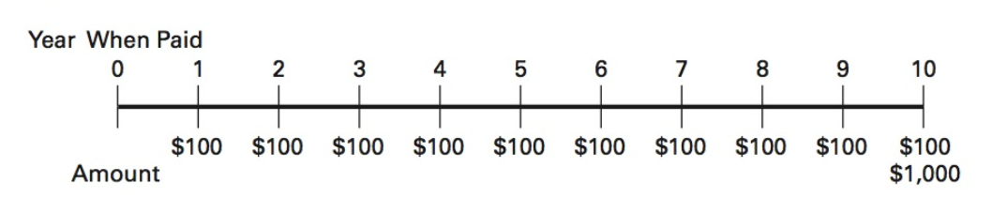
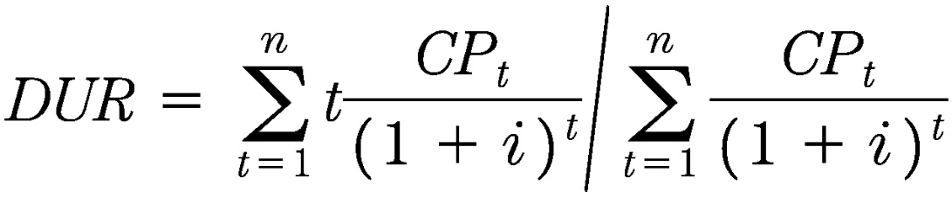
Duration (Effective maturity)
Invented by Frederick Macaulay more than 50 years ago.
A coupon bond is equivalent to a set of zero-coupon discount bonds.
A 10-year 10% coupon bond (F=$1,000)
Duration is a weighted average of the maturities of the cash payments.

Slide 34
Duration
Duration is a measure that incorporate the time of arrival of all cash flows on an asset or liability along with the asset or liability’s maturity date.
Duration is less than maturity because in present value terms, most cash flows are received before maturity.

Slide 35
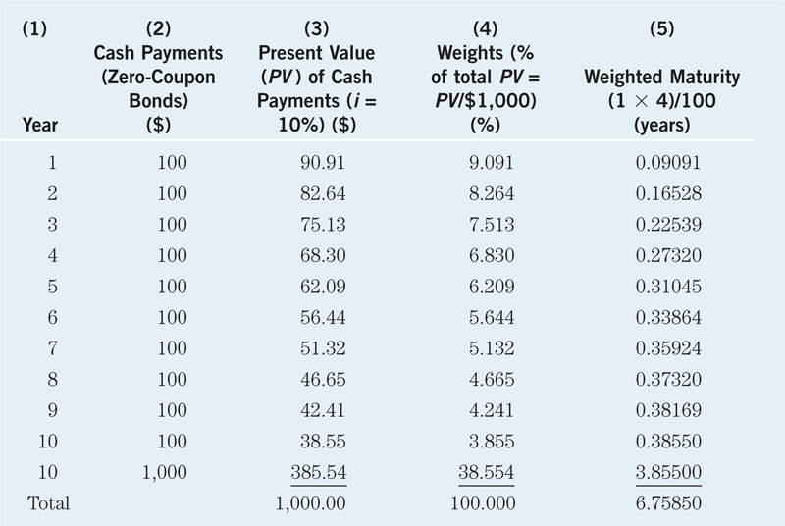
Table 3.3 Calculating Duration on a $1,000 Ten-Year 10% Coupon Bond When Its Interest Rate Is 10%

Slide 36
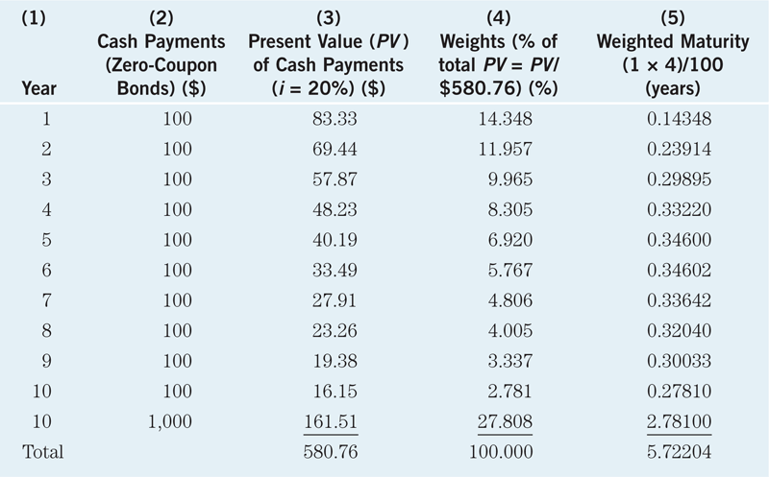
Table 3.4 Calculating Duration on a $1,000 Ten-Year 10% Coupon Bond When Its Interest Rate Is 20%

Slide 37
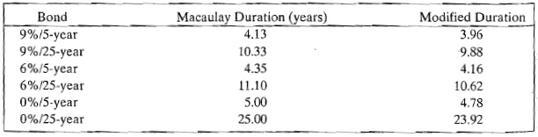
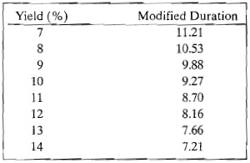
Properties of Duration
Assume: initial yield is 9%
Modified duration of a 25-year 9% coupon bond at various yield levels

Slide 38
Key facts about duration
All else equal, when the maturity of a bond lengthens, the duration rises as well
All else equal, when interest rates rise, the duration of a coupon bond fall
The higher the coupon rate on the bond, the shorter the duration of the bond
Duration is additive: the duration of a portfolio of securities is the weighted-average of the durations of the individual securities, with the weights equaling the proportion of the portfolio invested in each security

Slide 39
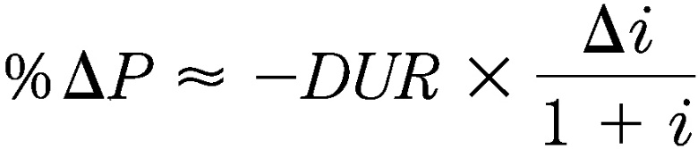
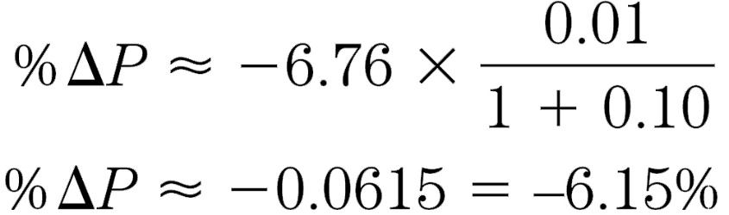
Duration and Interest-Rate Risk
i ↑ 10% to 11%:
Table 3.3, 10% coupon bond, DUR is 6.76 years

Slide 40
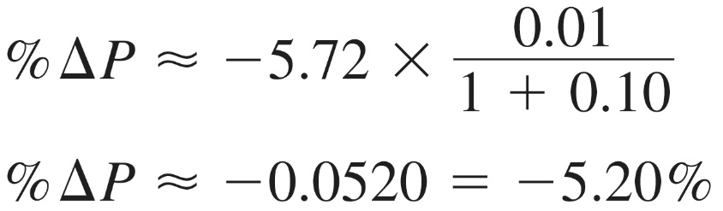
Duration and Interest-Rate Risk (cont.)
i ↑ 10% to 11%:
Coupon bond with DUR = 5.72 years
The greater the duration of a security, the greater the percentage change in the market value of the security for a given change in interest rates
Therefore, the greater the duration of a security, the greater its interest-rate risk

Slide 41
Duration
It is a measurement of how long, in years, it takes for the price of a bond to be repaid by its internal cash flows. 1. Zero-Coupon Bond – Duration is equal to its time to maturity. 2. Vanilla Bond - Duration will always be less than its time to maturity.

Slide 42
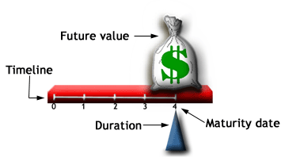
Duration of a Zero-Coupon Bond

Slide 43
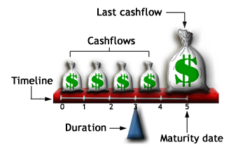
Duration of a Vanilla Bond

Slide 44
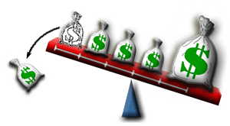
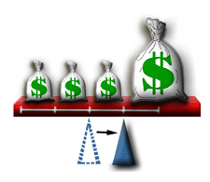
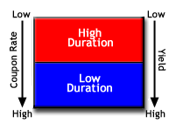
Factors Affecting Duration

